Slide 1
EE232
Digital Circuits
Course Project

Slide 2
Contribution by
Akhil Singh (2004203)
Tejas Lolage (2004220)
Prateek Singhal (2004227)
Dhanvin Prajapati (2004225)
Course instructor
Nandakumar Nambath

Slide 3
Title of the project
Digital Clock with Reset option.
Objective of the experiment
To design, implement and simulate a digital clock that displays time with the
help of seven segment displays using VHDL language.

Slide 4
Abstract and Introduction
The topic of this project is digital clock. Although there exist many digital clocks available for buying, we wanted to learn the concepts that undergo in making these digital clocks.
This is a good beginning spot for us to get more insight into using 7-segment displays and programming using VHDL, hence the choice of this topic.
Here input clock signals are given which are programmed to display time in hour:minutes:seconds (hh/mm/ss) format on a 7-segment LCD display.
A reset button has also been programmed in order to reset time.
Hence a complete digital clock which is available in the market on the FPGA.

Slide 5
System Overview
This clock follows the 24 hour clock system.
The ones place in second will reset after every ten (i.e. 0 to 9) cycles and tenth place in second will reset after every six (i.e. 0 to 5) cycles. And the same goes for the digits of minute.
In hour, when tenth place is 0 and 1, the ones place will reset after every ten (i.e. 0 to 9) cycles but when tenth place is 2, the once place will reset after four (i.e. 0 to 3) cycles.

Slide 6
Working
Clock signal and Reset signal were given as input to get the hexadecimal output on the 7-segment display.
Clock signal of 50 MHz was given which was used to generate 6 clock signals with the help of clock divider. These clock signals will be fed to the 6 generic counters that would generate six different outputs according to the format of HH: MM: SS (Hours: Minutes: Seconds).
Now the challenge is to reset the unit place of seconds, minutes and hour to 0 once it crosses nine and simultaneously increasing the value of the tens place of the corresponding number. For ex, once the time is 00:00:09, it should show 00:00:10th next second, similarly with the minute and the hour place too. This was achieved by giving the active low load signal to generic counters, which would be low whenever the Boolean expression generated by and, or and not gates give the output LDN as 0. Four the hour hand, we have to reset the clock to 00:00:00 once it crosses 23:59:59 which was again achieved by the help of these gates.
Once the correct binary output signal is generated, we converted it to SSD format with the help of Binary code to SSD converter so that it can display time on the 7-segment display on the FPGA. A reset button was also there which could reset the time to 00:00:00.

Slide 7
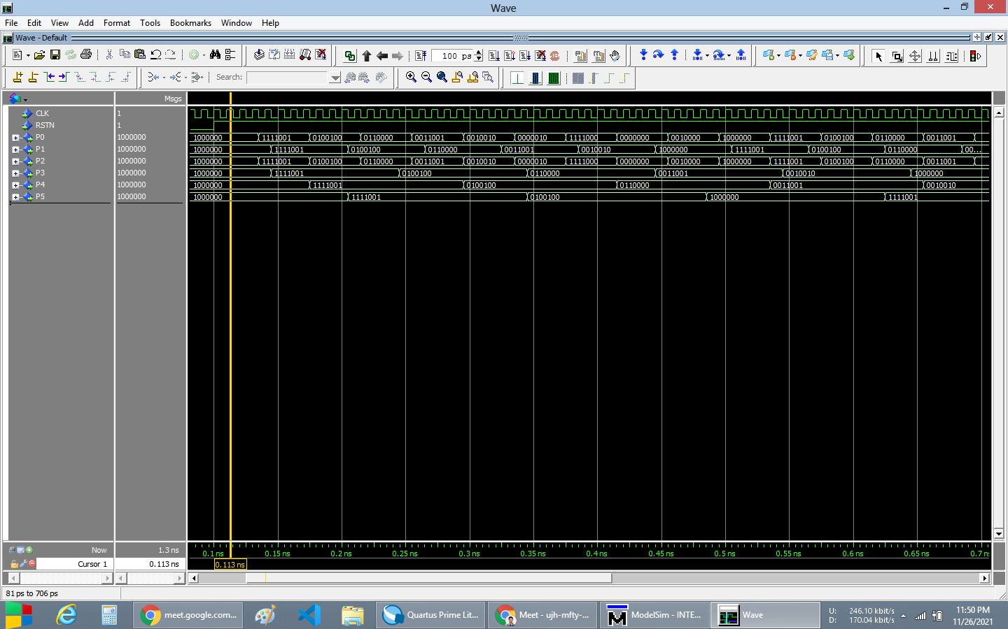
RTL simulation

Slide 8
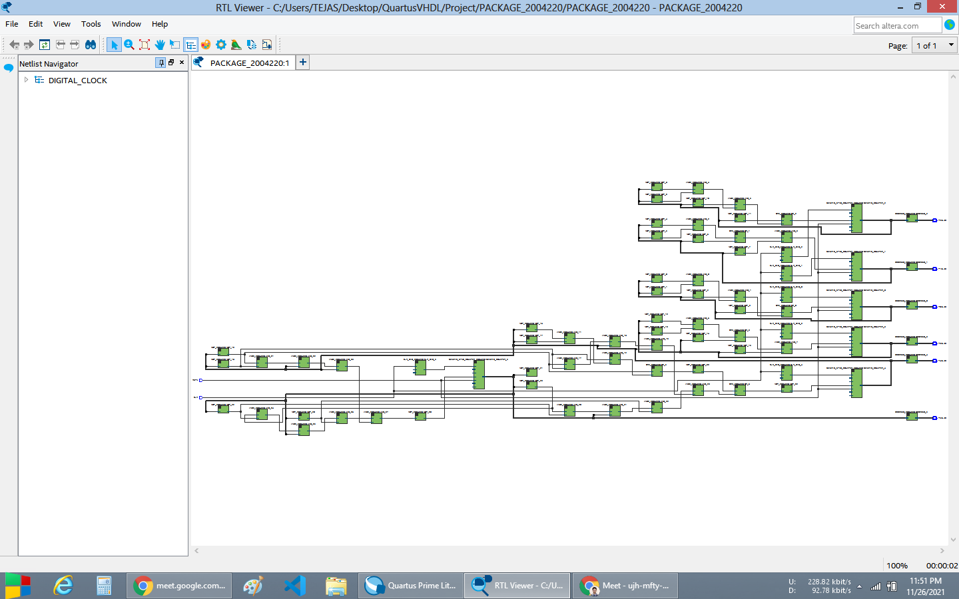
Net list viewer

Slide 9
Drive link
https://drive.google.com/drive/folders/1XhvIlkaNDHAlj4BBYQv1uWdq2-4FZ3Ot?usp=sharing

